Slide 1
MANET P2P file sharing over NDN
Spyridon Mastorakis, Tianxiang Li, Lixia Zhang
UCLA
4th NDN Community Meeting
NIST, Gaithersburg, MD
September 2018

Slide 2
Problem Statement
Efficient information/file sharing in wireless ad-hoc communication scenarios
Example use-cases: battlefield, rural areas, crowded events
Notes:
Get rid of bullets 3 and 4

Slide 3
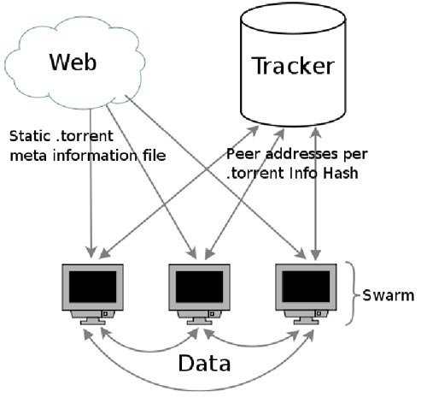
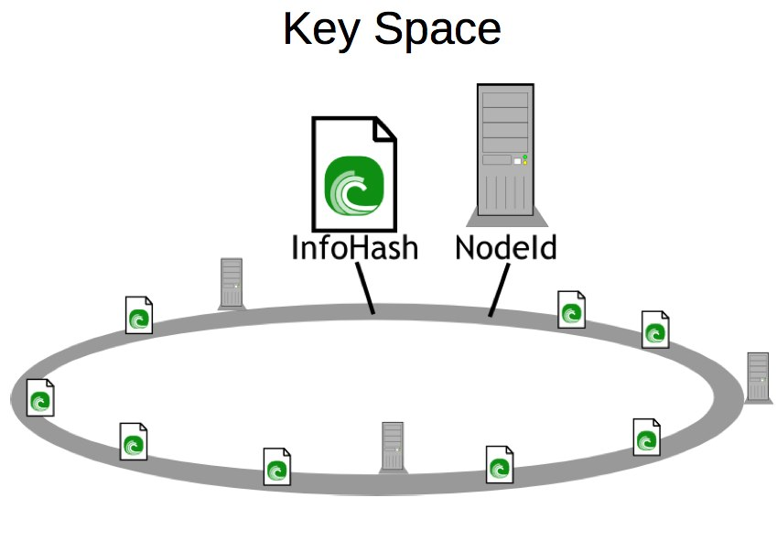
P2P file sharing over the Internet
Tracker
DHT
Notes:
BitTorrent over stable connectivity
Newcomers contact a tracker or use a DHT to find peers
Application focuses on data, network focuses on nodes
Peers learn which IP address has what data
Overlay implementation
Learn more peers by asking already known ones
Application layer measurements & tit-for-tat
Data authentication through hashes in torrent-file
Trust is based on getting the right torrent-file but peers cannot verify that

Slide 4
MANET P2P file sharing
Sharing file among ad-hoc encounters
How to even get an IP address?
Intermittent connectivity
How to make the most out of each encounter?
A separate TCP connection to each encountered peer
Different than P2P file
sharing over the Internet!

Slide 5
What NDN has to offer to P2P file sharing in MANET?
Use application assigned names for secure data retrieval
Independent of nodes and their current location
Named and secured data can be served from anywhere
Take advantage of broadcast nature of wireless communication medium
Nodes have built-in storage for pending Interests (PIT) and data (CS)
Carry Interests and data around
Utilize any ad-hoc connectivity to forward packets
Notes:
Peers decide whether they trust data producing peer
How NDN can help address those 3 problems?

Slide 6
Design Objectives
Efficient file sharing with minimal overhead and energy consumption
Lightweight data authentication by attaching data hash in the name
No need for expensive signature verification
Leverage peer interactions to make the most out of each encounter

Slide 7
Design Overview
Peer and torrent discovery
Torrent file retrieval
Data advertisement exchange: let others know what data a peer has
Data fetching

Slide 8
Peer and torrent discovery
Discover neighboring peers
Discover what torrents neighboring peers have data for
Ideal: leverage existing 802.11 (ad-hoc mode) beacons
In practice: application-layer beaconing

Slide 9
Torrent-File
Name: <torrent-name>/torrent-file/<hash-of-torrent-file>
Contains names for the data of each file in the torrent
Signed by the original data producer
Verify signature based on pre-existing trust rules and anchors
Verify data integrity through the hash in the name

Slide 10
Data Advertisements
Data advertisements express which torrent data a peer has
Hierarchical naming with application-defined conventions for torrent data: <torrent-name>/<file-name>/<segment-number>
Compact encoding of data advertisements through a bitmap
Increase data availability within peer’s communication range:
Prioritize the data advertisements of peers that have most of the data that is still missing
Notes:
Peers are aware of as many available data packets as possible within their communication range

Slide 11
Data Fetching
Variations of the Rarest Piece First (RPF) strategy to fetch rare packets first
Encounter-based RPF
Rare packets are determined based on a history of encounters among peers
Local neighborhood-based RPF
Rare packets are determined based on the available data within a peer’s communication range

Slide 12
Progress so far
Working prototype on MacOS based on Apple’s WiFi ad-hoc implementation
Experiments conducted on UCLA campus
Simulation experiments for evaluation at scale
Ongoing effort:
Comparison with IP-solutions
Merkle tree to reduce torrent-file size
Multi-hop communication design
Notes:
Add graphs

Slide 13
How to learn more
Published work on P2P file sharing over the Internet:
Spyridon Mastorakis, Alexander Afanasyev, Yingdi Yu, and Lixia Zhang,
“nTorrent: Peer-to-Peer File Sharing in Named Data Networking”,
in proceedings of the 26th International Conference on Computer Communications and Networks (ICCCN), July 2017.
Link: https://named-data.net/wp-content/uploads/2017/06/2017-icccn-ntorrent.pdf
Thank you for your time!
Questions?

Slide 14
Data Authentication
Torrent file contains names of data to request
Each data packet has the hash of the packet as the last name component
Peers request data with a name including the hash of each data packet
Peers have to verify the signature of the torrent file
Pre-defined set of trust anchors
Peers leverage the hash in the name to authenticate torrent data

Slide 15
Use case #1

Slide 16
Design Overview
Peer 1
Peer 2
1a. Discovery Interest
1b. Discovery data
2a. (If needed) Interest for torrent-file
2b. (If needed) Torrent-file
3a. Data advertisement Interest
3b. Data advertisement Data
4a. Interest for torrent data
4b. Torrent data
…
Notes:
Application layer beaconing
Torrent-file
Data Advertisements (compact encoding through bitmaps)
Prioritized transmission of data advertisements
Collision Avoidance
Rarest Piece First (RPF)-based strategies
Data already exists, that's why you can create the torrent
Change discovery

Slide 17
Discovery & Torrent-File Exchange
B
Torrent-file
Interest for torrent-file
Discovery Interest
A
D
C
Beacon Data

Slide 18
Prioritized Data Advertisements
B
Bitmap Interest
Bitmap Interest
A
D
Bitmap
Data
Bitmap
Data
C
Notes:
Peers may not have time to exchange all the bitmaps when multiple peers are within their communication range
They might need to exchange a sample of bitmaps only. To this end, we need to prioritize bitmaps that let peers know about as many pieces of data available across their neighborhood

Slide 19
Use case #2

